Slide 1
Jquery & Ajax
Week 3

Slide 2
What is Jquery and Ajax Do?
Jquery is a javascript library. It allows us to…
Interact with HTML elements on our webpage
Retrieve data from a web server (GET Requests) via AJAX method

Slide 3
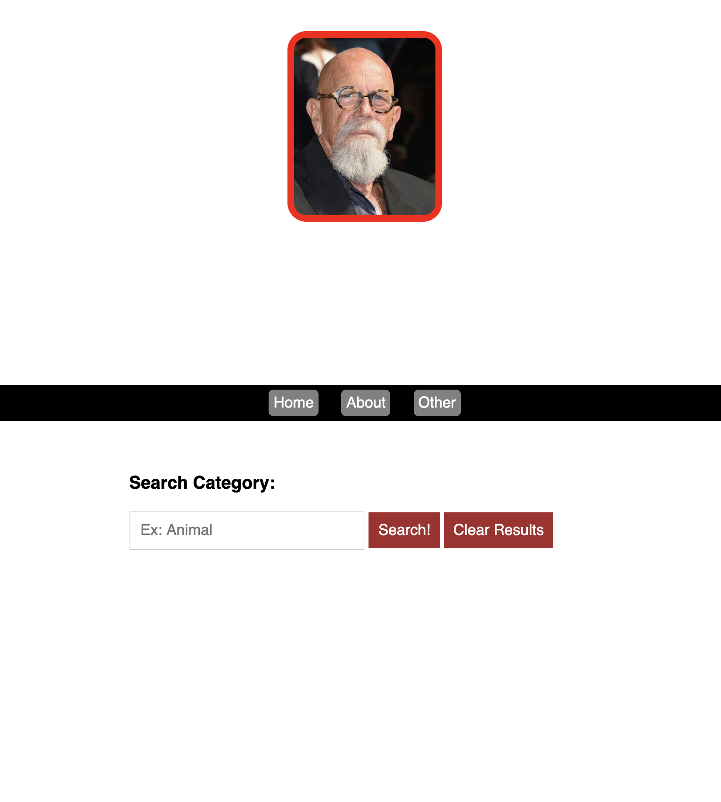
<a href="http://google.com">Home</a>
<a href="http://facebook.com">About</a>
<a href="#">Other</a>
<button>Search! </button
<button>Clear Results </button>
<input type="text" placeholder="Ex: Animal">

Slide 4
<a href="http://google.com">Home</a>
<a href="http://facebook.com">About</a>
<a href="#">Other</a>
<button id="search_button">Search! </button
<button id="clear_button">Clear Results </button>
<input id="category_field" type="text" placeholder="Ex: Animal">

Slide 5
<a href="http://google.com">Home</a>
<a href="http://facebook.com">About</a>
<a href="#">Other</a>
<input id="category_field" type="text" placeholder="Ex: Animal">
<button id="clear_button">Clear Results </button>
<button id="search_button">Search! </button
<div id="results_container"> </div>

Slide 6
Adding functionality to HTML elements
What does adding functionality to elements mean?
Executing a block of code once a HTML element has been interacted with
Steps
Capture the HTML element/elements via Jquery
Add an event listener to the HTML element
Write code to handle event

Slide 7
Step 1) Capture the HTML Element using Jquery
$("a"); // select by tag name
$(".navigation"); // select by class
$("#search_button"); // select by id

Slide 8
Step 2) Add an event listener
What are event listeners?
A procedure in Javascript that waits for an event to occur.
$("#search_button").on("click", function() {}) // listens for when “search_button” element is “clicked”
$("#search_button").on("hover", function() {}, function() {}) // listens for when mouse hovers over element
$("#category_field").on("keydown", function() {}) // listens for when a key is pressed in this input element

Slide 9
Step 3) Write code to handle event
$("#search_button").on("click", function() {
// Code to execute when the event on “search_button” occurs
alert("hello world");
})

Slide 10
Modifying/Capturing the contents of HTML Elements
Capturing
Capture the content of an input element : var content = $("#category_field").val();
Capture the inner html of an element: var content = $("#results_container").html();
Modifying
Append HTML to an element: $("#results_container").append("<h2>This is a title</h2>")
Change HTML to an element: $("#results_container").html("<h2>This is a title</h2>")
Empty the contents of an element: $("#results_container").empty();
Empty the contents of an INPUT element: $("#category_field").val(‘’);

Slide 11
Using AJAX to retrieve data from an api
Result of GET requests
SERVER
$.get("server_address”, function(data) {
// data now contains results from GET request
console.log(data);
}
// javascript code
GET

